Slide 1
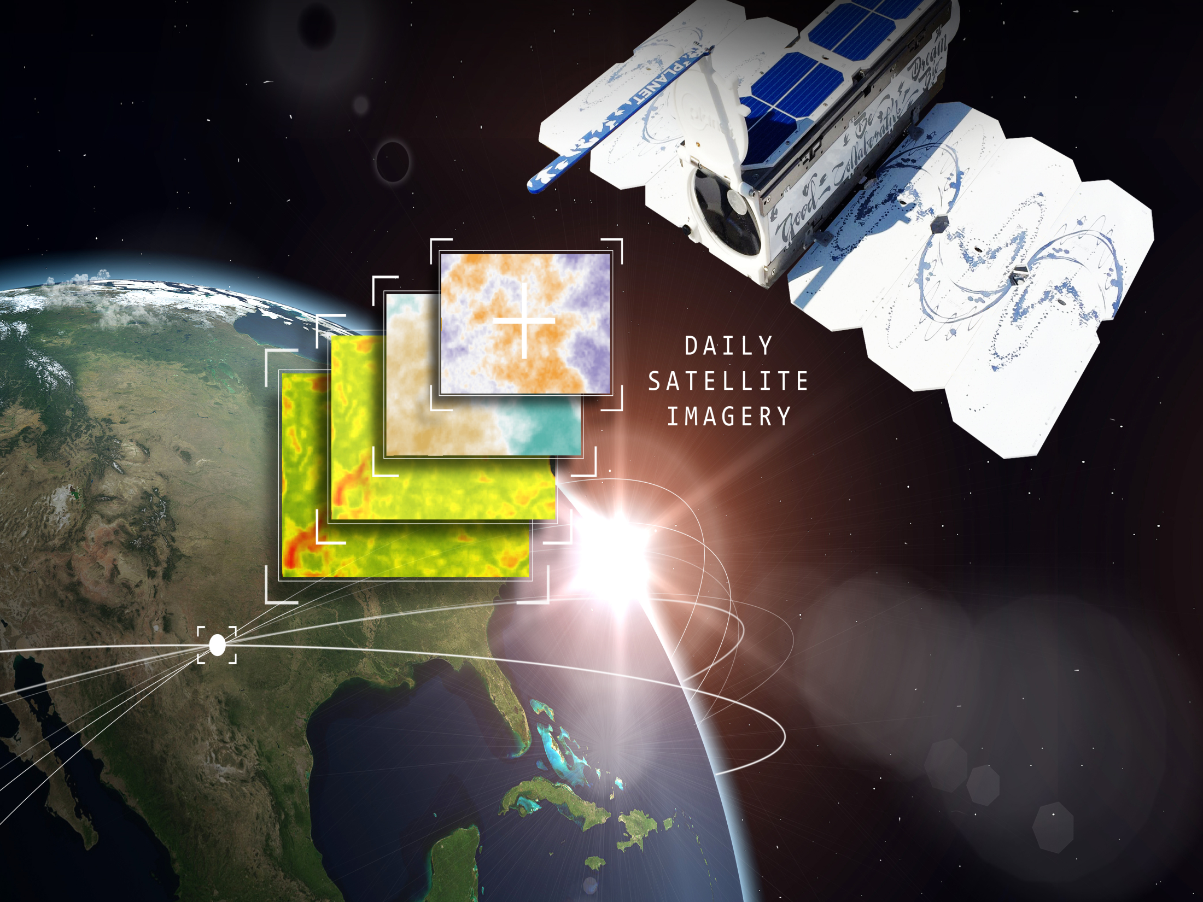
Computer Vision DL based Solution

Slide 2

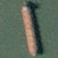
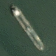
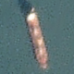
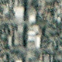
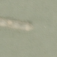
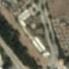
Problem Statement
Hypothesis Generation
Hypothesis Validation
Exploratory Data Analysis
Data Preprocessing
Feature Engineering
Model Building
Model Performance
Data Problem
Problem Statement
Image chips extracted from Planet satellite Imagery and labeled with either a "ship" or "no-ship" classification depending on whether the respective image contains a ship or no. In future, there is a need for using an algorithm which could identify the presence of ship in these images which would lead to a cascading decision in one of the sub system/s in the landscape.

Slide 3
Problem Statement
Hypothesis Generation
Hypothesis Validation
Exploratory Data Analysis
Data Preprocessing
Feature Engineering
Model Building
Model Performance
Data Problem
Feature | Hypothesis
Image Size | Images should be standard size of 255 * 255 ??
Image Quality | It needs at least a 255 * 255 Image width * height to classify as a good quality image.
Centered Image | Images will not be centered at the middle, there will be processing required for the same.
Balanced Classes | The count of labeled classes should be equal across all the classes.
Longitude Latitude | Satellite Images are dependent on the latitude and longitude of the area.
Temporal Aspect | Image data provided is dependent on the time of the day when the data is captured.
Aspect Ratio | Set of Images captured might be varied in values.
Continuous Analysis | There should be image dependency within the captured images for forming the analysis.
Incorrect Images | Captured set of images might contain incorrectly Blank images, malformed images.
Unlabelled Data | Captured set of images might contain incorrectly labeled images, missing images.
Source of Data | The source of data used to capture the images is same for all the samples.
Volume of Input Data | The volume of data would be tremendous since the rate of capture is high from the satellite.
No. of channels | Captured images should be having 3 channels – Red, Green, Blue (RGB)
Format of Images | Captured images should be either of one of the standard images formats - .jpg/.png
Image Metadata | Metadata supporting image is provided as part of dataset.
Metrics for Evaluation of Model Performance | Suitable metrics could be used for evaluating the performance of the mode.
Impact of time zone on capturing of images | Satellite operates from outside of earth atmosphere, does the changing time zone and day time affects the quality of captured data.
Deployment Aspects of the model | Model might be deployed in the online or batch mode.

Slide 4
Problem Statement
Hypothesis Generation
Hypothesis Validation
Exploratory Data Analysis
Data Preprocessing
Feature Engineering
Model Building
Model Performance
Data Problem
Feature | Hypothesis | Validation
Image Size | Images should be standard size of 255 * 255 ?? | Image size – 80 * 80(constant)
Image Quality | It needs at least a 255 * 255 Image width * height to classify as a good quality image. | Image quality – below average
Centered Image | Images will not be centered at the middle, there will be processing required for the same. | Image is centered in middle
Balanced Classes | The count of labeled classes should be equal across all the classes. | Imbalance two class dataset
Longitude Latitude | Satellite Images are dependent on the latitude and longitude of the area. | Longitude/Latitude have no impact
Temporal Aspect | Image data provided is dependent on the time of the day when the data is captured. | Captured images are independent of time.
Aspect Ratio | Set of Images captured might be varied in values. | Captured images are of equal width and height i.e. 80 pixels
Continuous Analysis | There should be image dependency within the captured images for forming the analysis. | It Is stationary or offline mode analysis of captured images
Incorrect Images | Captured set of images might contain Blank images, malformed images. | All images are properly captured as per their respective specifications.
Unlabelled Data | Captured set of images might contain incorrectly labeled images, missing images. | All the labels are present for 4k images
Source of Data | The source of data used to capture the images is same for all the samples. | Yes, the source is same.
Volume of Input Data | The volume of data would be tremendous since the rate of capture is high from the satellite. | 4 k images – 1 k for ship containing and remaining no ship containing.
No. of channels | Captured images should be having 3 channels – Red, Green, Blue (RGB) | RGB images.
Format of Images | Captured images should be either of one of the standard images formats - .jpg/.png | PNG
Image Metadata | Metadata supporting image is provided as part of dataset. | There are few other variables captured like Longitude/Latitude/id etc.
Metrics for Evaluation of Model Performance | Suitable metrics could be used for evaluating the performance of the mode. | Since this is a binary classification problem Accuracy and Loss is used for measuring the performance of the built model versions.
Impact of time zone on capturing of images | Satellite operates from outside of earth atmosphere, does the changing time zone and day time affects the quality of captured data. | No Impact as notified in the problem statement
Deployment Aspects of the model | Model might be deployed in the online or batch mode. | This would be batch mode analysis.

Slide 5
Problem Statement
Hypothesis Generation
Hypothesis Validation
Exploratory Data Analysis
Data Preprocessing
Feature Engineering
Model Building
Model Performance
Data Problem

Slide 6
Problem Statement
Hypothesis Generation
Hypothesis Validation
Exploratory Data Analysis
Data Preprocessing
Feature Engineering
Model Building
Model Performance
Data Problem
Description | Remarks
Descriptive Statistics | Not Required
Interferential Statistics | NA
Variables | Image Name Image Label Serial Id. Longitude Latitude
Dependent Variable | Image Label
Independent Variable | Image Name Serial Id. Longitude Latitude
Variables Types | Image Name Image Label Serial Id. Longitude Latitude | String Binary Float Float Float
Content type | Image – 80*80 Pixels

Slide 7
Problem Statement
Hypothesis Generation
Hypothesis Validation
Exploratory Data Analysis
Data Preprocessing
Feature Engineering
Model Building
Model Performance
Data Problem

Slide 8
Problem Statement
Hypothesis Generation
Hypothesis Validation
Exploratory Data Analysis
Data Preprocessing
Feature Engineering
Model Building
Model Performance
Data Problem

Slide 9
Problem Statement
Hypothesis Generation
Hypothesis Validation
Exploratory Data Analysis
Data Preprocessing
Feature Engineering
Model Building
Model Performance
Data Problem

Slide 10
Problem Statement
Hypothesis Generation
Hypothesis Validation
Exploratory Data Analysis
Data Preprocessing
Feature Engineering
Model Building
Model Performance
Data Problem

